Slide 1
Our Architecture Principles

Slide 2

Architecture Principles: Primary Goals
Any Technology
Templated Output
Any Touchpoint – web, LOB app, mobile, …
Decoupled Deployment
Content Reuse
Central Asset Repository
Presentation Reuse
Presentation Components
Pluggable Experiences
API-driven Microservices
Open-ended Scalability
Global Cloud
Transparent High-Availability
Above-Cloud Engineering
Highest Levels of Information Security
Audits, Certifications, SaaS

Slide 3
Architecture Principles: Primary Goals
Any Technology
Templated Output
Any Touchpoint – web, LOB app, mobile, …
Decoupled Deployment
Content Reuse
Central Asset Repository
Presentation Reuse
Presentation Components
Pluggable Experiences
API-driven Microservices
Open-ended Scalability
Global Cloud
Transparent High-Availability
Above-Cloud Engineering
Highest Levels of Information Security
Audits, Certifications, SaaS

Slide 4
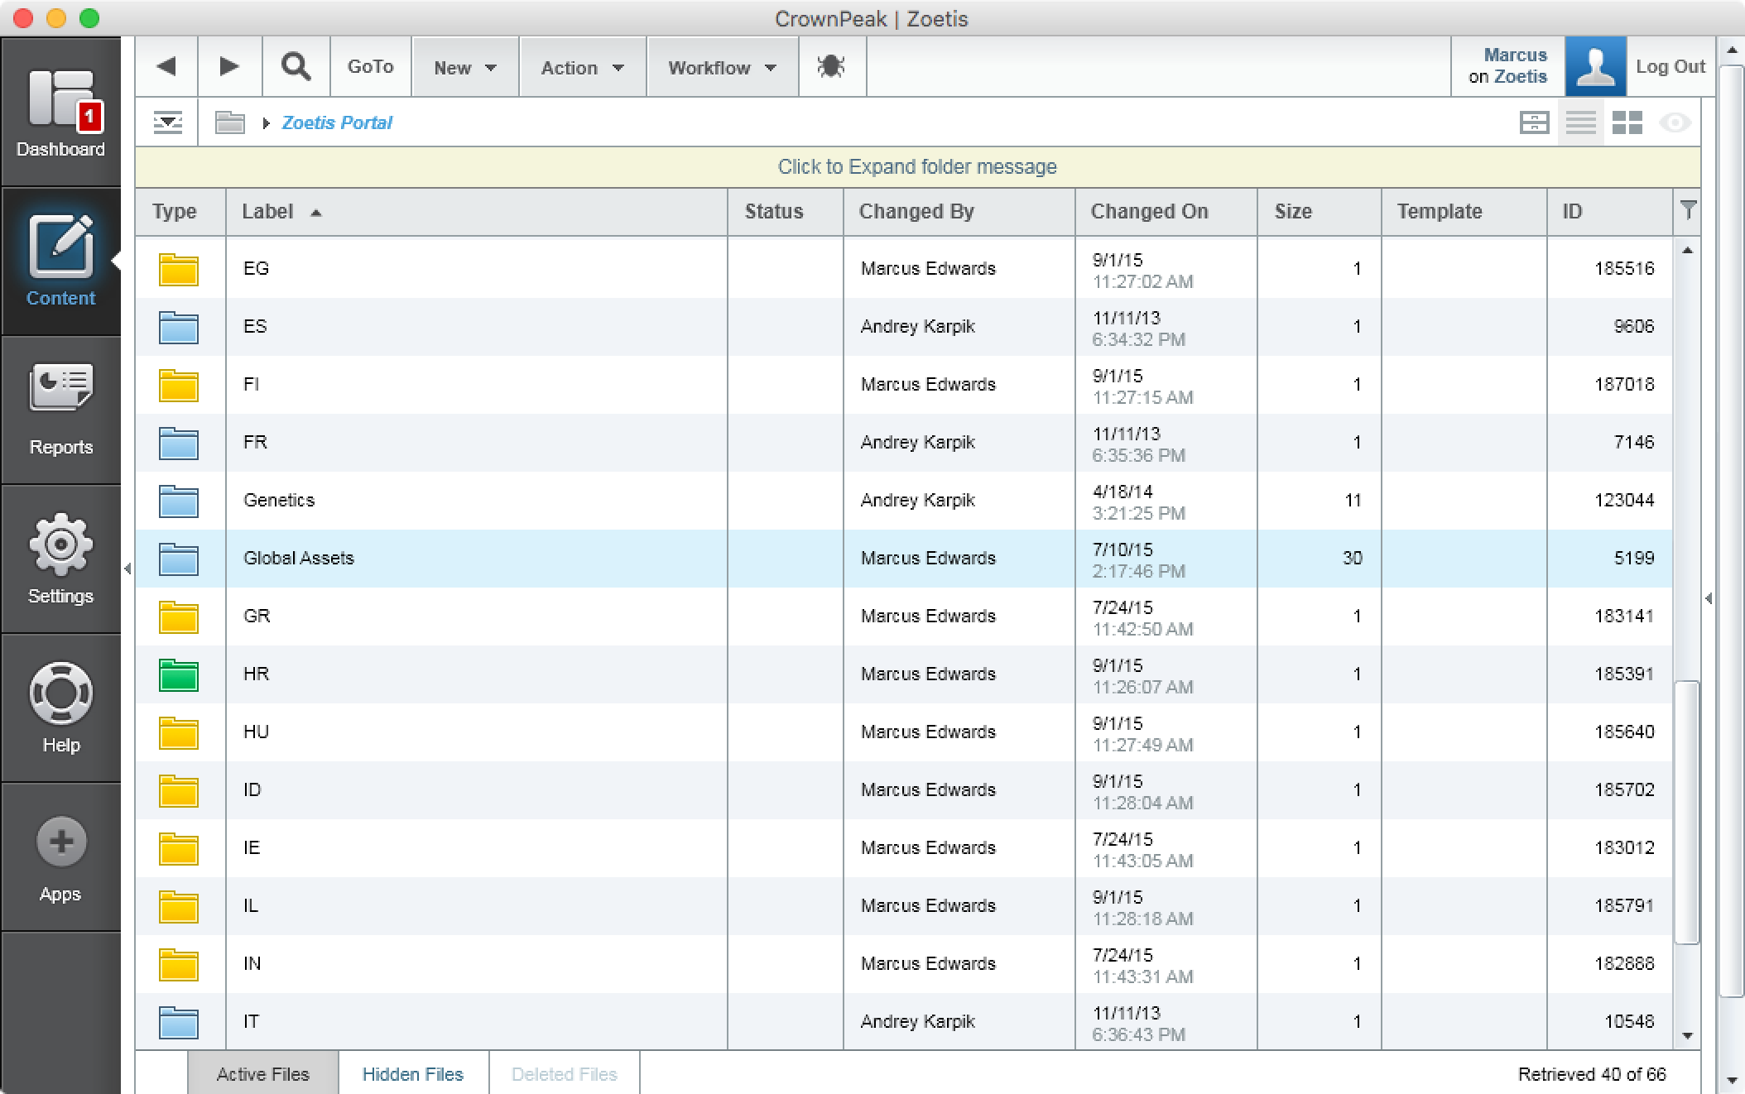
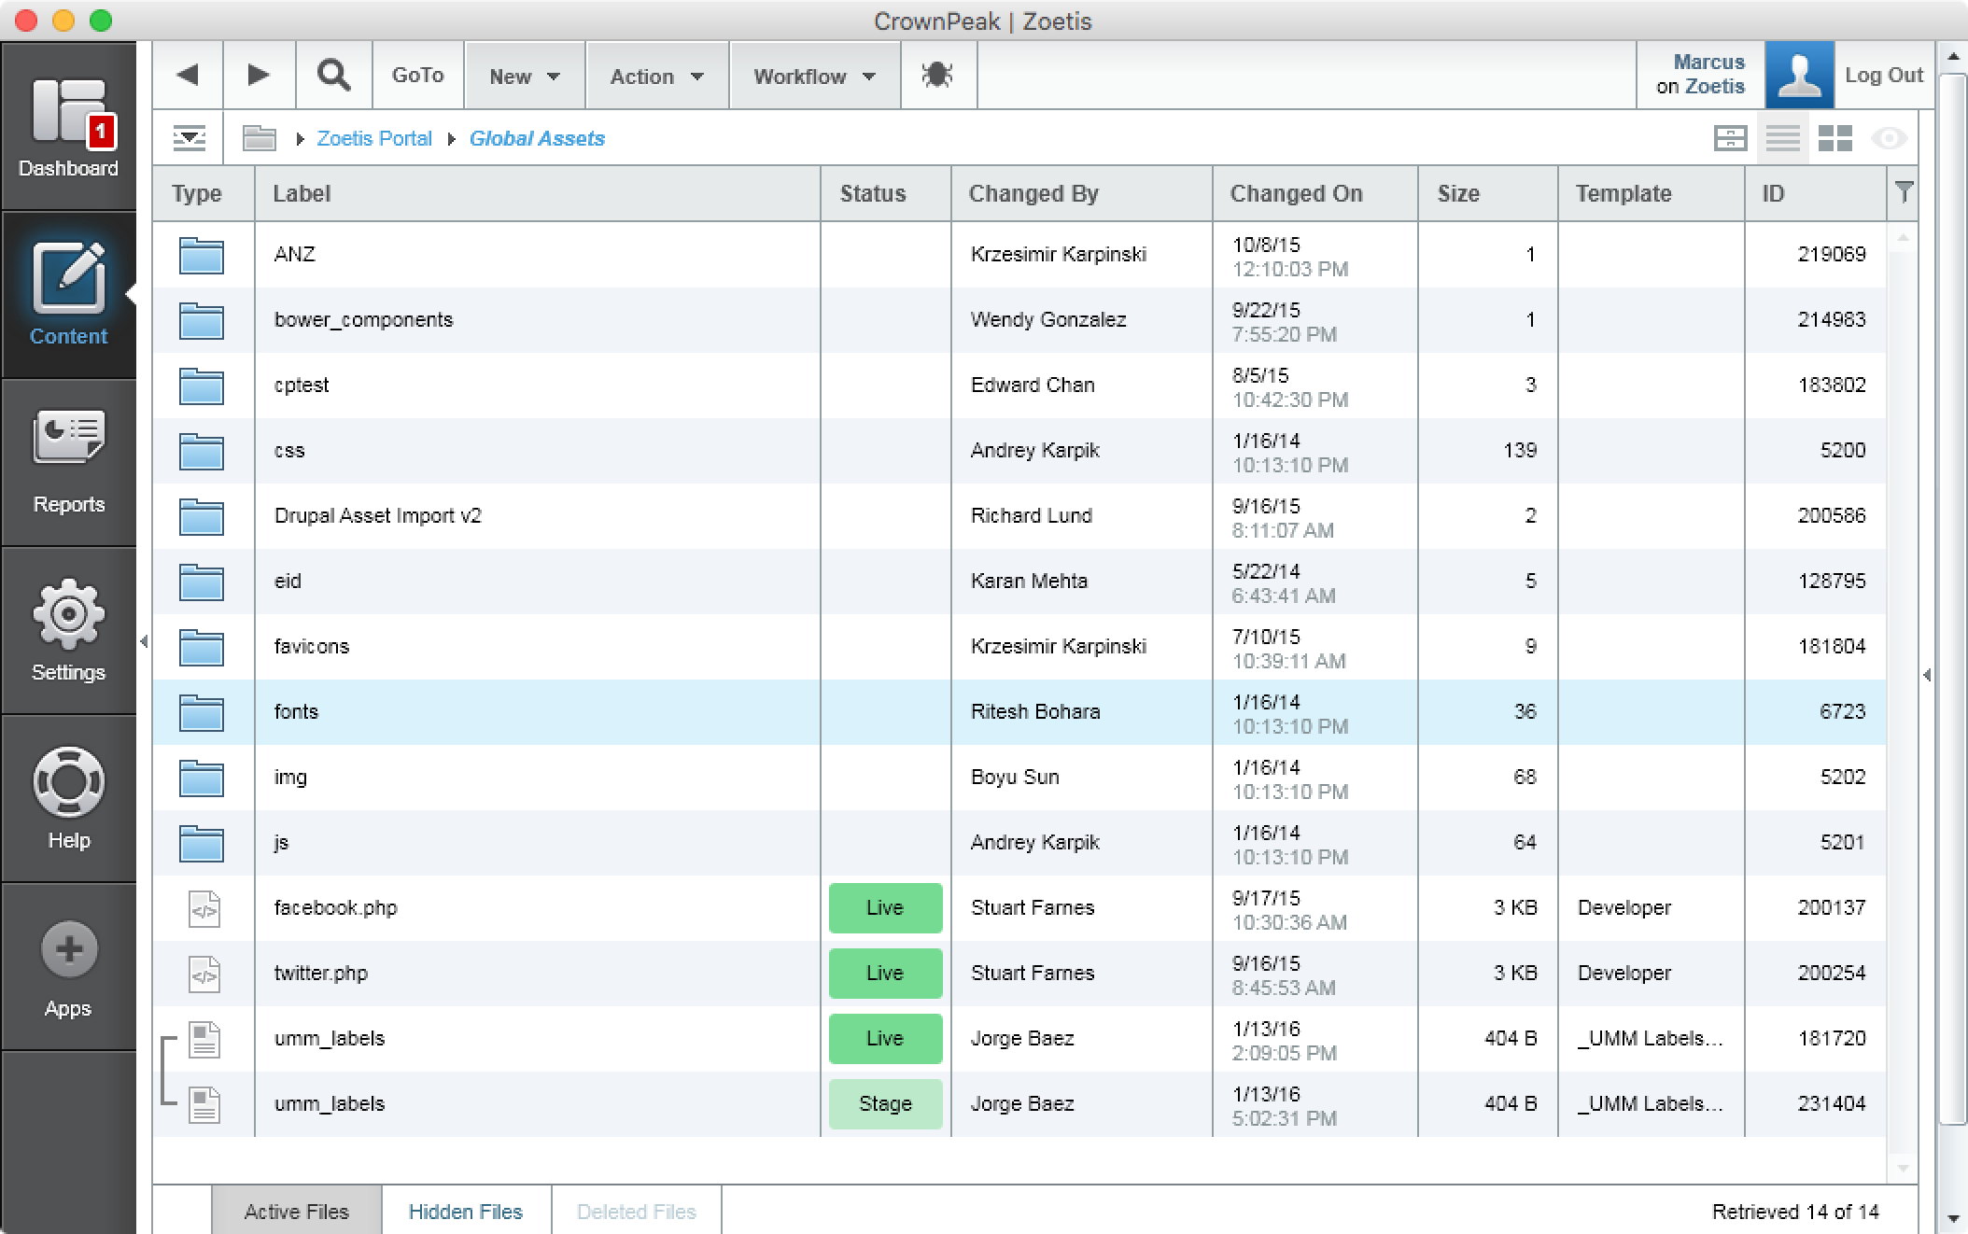
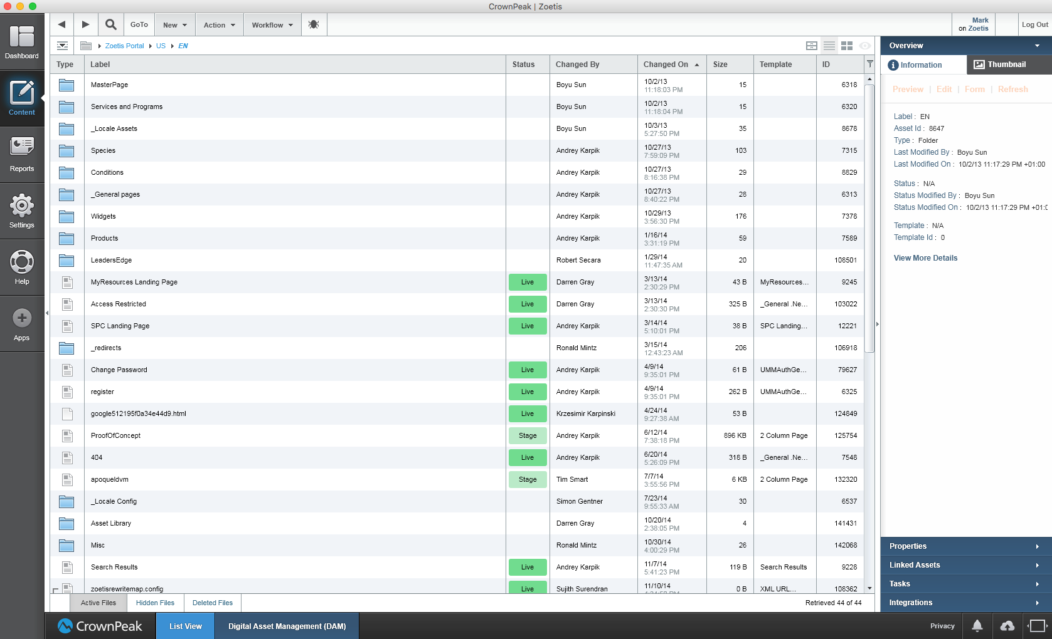
Case Study: Zoetis – Organizing CMS Repo
Web & Mobile sites hosted by Crownpeak
78 Globally distributed sites
Central Asset Repository organized by country
Each site has read access to shared Assets
Crownpeak helped build Drupal Migration Kit - allowed all to migrate content to Crownpeak in a standard way
Zoetis further organized content, not by Geography but by business line
Crownpeak permissions control which authors can do what, and where
Notes:
Organize a top repository

Slide 5

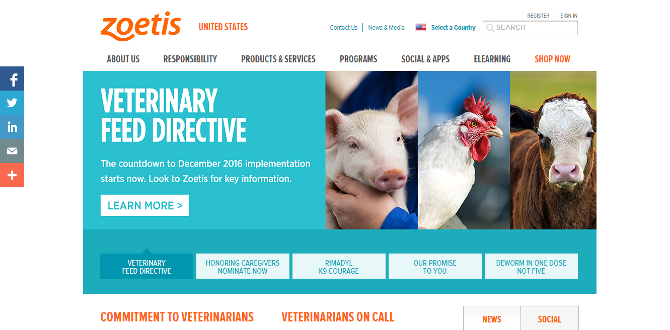
Case Study: Zoetis
Web & Mobile sites hosted by Crownpeak
78 Global websites consolidated to 11 in under 2 months
87 Languages
18,000 Pages migrated
1 HTML Framework
Design, Implementation & Migration / Testing for new projects in 4 weeks!

Slide 6
Case Study: Zoetis
24%
49%
24%
Increase in lead conversions
Increase in content consumption across web / mobile
Increase in unique visitors
48%
26%
49%
Increase in
brand awareness
Reduction in operating costs of launching / managing web experiences
Reduction in IT operating costs with cloud WCM system

Slide 7
Architecture Principles: Primary Goals
Any Technology
Templated Output
Any Touchpoint – web, LOB app, mobile, …
Decoupled Deployment
Content Reuse
Central Asset Repository
Presentation Reuse
Presentation Components
Pluggable Experiences
API-driven Microservices
Open-ended Scalability
Global Cloud
Transparent High-Availability
Above-Cloud Engineering
Highest Levels of Information Security
Audits, Certifications, SaaS

Slide 8
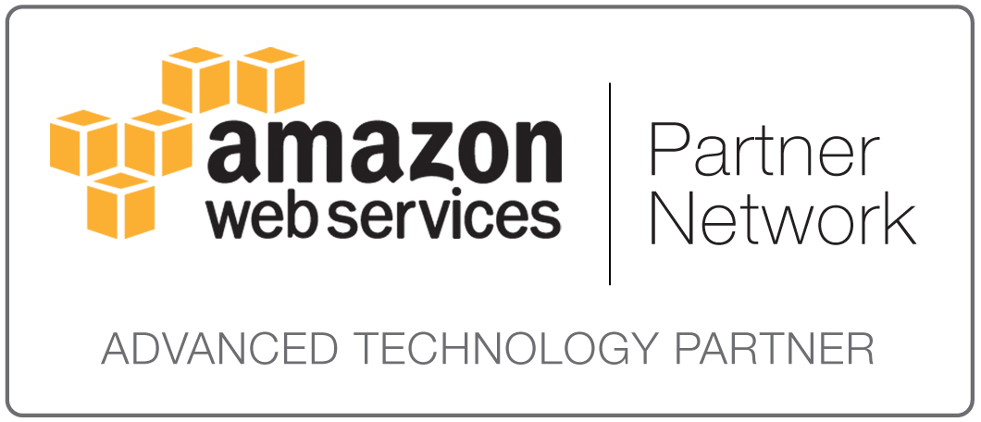
High Availability
us-east-1a
Regions
us-east-1b
us-east-1c
USA N. Va
USA San Jose
USA Oregon
India
EU Ireland
EU Frankfurt
Singapore
South Korea
China
Japan
Australia
Brazil
Notes:
We build on AWS
We’re an Advanced Technology Partner – AWS has confidence in our ability to engineer HA and secure infrastructure. Cloud engineering: Architect for failure.
AWS has a number of global regions, and each region typically has two or more ‘availability zones’ geographically distinct data centres.
All of our core services are replicated across three availability zones. Our customer hosting pods are replicated across two AZ.
We can deploy into any region. Ones in red are where we currently host services

Slide 9
Architecture Principles: Primary Goals
Any Technology
Templated Output
Any Touchpoint – web, LOB app, mobile, …
Decoupled Deployment
Content Reuse
Central Asset Repository
Presentation Reuse
Presentation Components
Pluggable Experiences
API-driven Microservices
Open-ended Scalability
Global Cloud
Transparent High-Availability
Above-Cloud Engineering
Highest Levels of Information Security
Audits, Certifications, SaaS

Slide 10

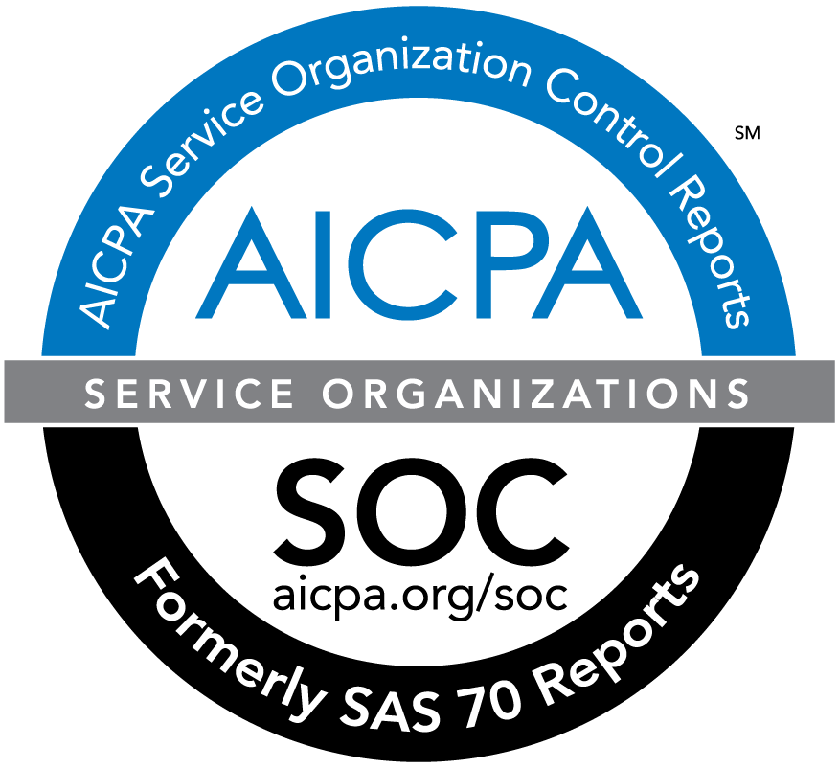
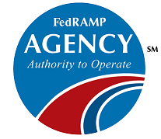
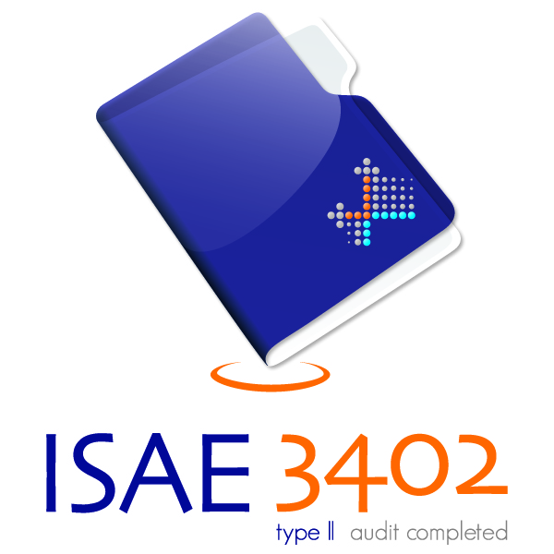
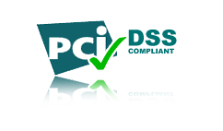
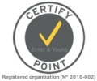
Information Security: Certifications & Audits
SSAE 16 SOC 1 Type 2
SSAE 16 SOC 2 Type 2
ISAE 3402
FISMA (Moderate – NIST 800-53)
TRUSTe Certified Privacy
EU-U.S. Privacy Shield
Swiss-U.S. Privacy Shield
www.crownpeak.com/privacy/
SSAE 16 SOC 1 Type 2
SSAE 16 SOC 2 Type 2
ISAE 3402
FedRAMP
FISMA (Moderate – NIST 800-53)
NIST 800-37
DIACAP
PCI DSS Level 1
ISO 27001
FIPS 140-2
aws.amazon.com/security/
Amazon CloudFront
Approx. 50 edge locations (or PoPs)
US, Europe, Asia, South America & Australia.
Notes:
Everyone offering a cloud solution, prob from AWS;
Everyone relying on AWS credentials (as they should);
AWS provides certification on their kit, but only the kit;
Protection from the concrete of the DC floor, to the fingertips that are driving the browser.
First WCM provider to submit ourselves to independent SSAE-16 operational control audit;
To date, the ONLY WCM provider that holds FISMA (Federal Information Security Act) – US Federal Government Agency need to adhere to this.
SSAE 16 – Operation Control Audit (are you running the business the way you say you are?). SOC2 is a standard specific to SaaS providers. SOC1 allows us to define our own audit scope, can’t include them in SOC2 – hence allows us to keep our customers aware;
ISAE 3402 (International equivalent of SSAE 16);
FISMA (Federal Information Security Management Act) – Certification – we don’t have substantial government present, but most large banking organisations use this for their own InfoSec program;
TRUSTe & Safe Harbor – Data protection privacy programs. We’ve been assessed against EU Data Protection Standards and found to be compliant.

